Slide 1
UNIT I – BASICS OF SDN
UNIT I – SESSION 1
SESSION 1
Introduction to SDN
Evolution of Switches and Control Planes
Cost
SDN Implications for Research and Innovation
Reference: Ref. 1, Ch. 2.1, 2.2, 2.3

Slide 2
Networking Basics
OSI model : The Open Systems Interconnection (OSI) model defines seven different layers of technology: physical, data link, network, transport, session, presentation, and ap‐ plication. This model allows network engineers and network vendors to easily dis‐ cuss and apply technology to a specific OSI level.
Switches
These devices operate at layer 2 of the OSI model and use logical local addressing to move frames across a network. Devices in this category include Ethernet in all its variations, VLANs, aggregates, and redundancies. It stores MAC address. In one organization.
Routers
These devices operate at layer 3 of the OSI model and connect IP subnets to each other. Routers move packets across a network in a hop-by-hop fashion. In different organization
Ethernet
These broadcast domains connect multiple hosts/ computer together on a common infra‐ structure through wire. Hosts communicate with each other using layer 2 media access control (MAC) addresses.

Slide 3
Networking Basics
IP addressing and subnetting
Hosts using IP to communicate with each other use 32-bit addresses. Humans often use a dotted decimal format to represent this address. This address notation in‐ cludes a network portion and a host portion, which is normally displayed as 192.168.1.1/24.
TCP and UDP
These layer 4 protocols define methods for communicating between hosts. The Transmission Control Protocol (TCP) provides for connection-oriented commu‐ nications, whereas the User Datagram Protocol (UDP) uses a connectionless para‐ digm. Other benefits of using TCP include flow control, windowing/buffering, and explicit acknowledgments.
ICMP
Network engineers use this protocol to troubleshoot and operate a network, as it is the core protocol used (on some platforms) by the ping and traceroute programs. In addition, the Internet Control Message Protocol (ICMP) is used to signal error and other messages between hosts in an IP-based network.
https://www.youtube.com/watch?v=1z0ULvg_pW8&list=PLBAxr3nJq2ByzDKbFPw3EiivVJeT73-tG&index=5

Slide 4
Networking Basics
Data center
A facility used to house computer systems and associated components, such as telecommunications and storage systems. It generally includes redundant or back‐ up power supplies, redundant data communications connections, environmental controls (e.g., air conditioning and fire suppression), and security devices. Large data centers are industrial-scale operations that use as much electricity as a small town.
MPLS
Multiprotocol Label Switching (MPLS) is a mechanism in high-performance net‐ works that directs data from one network node to the next based on short path labels rather than long network addresses, avoiding complex lookups in a routing table. The labels identify virtual links (paths) between distant nodes rather than endpoints. MPLS can encapsulate packets of various network protocols. MPLS supports a range of access technologies.

Slide 5
Networking Basics
Network topology
The arrangement of the various elements (links, nodes, interfaces, hosts, etc.) of a computer network. Essentially, it is the topological structure of a network and may be depicted physically or logically. Physical topology refers to the placement of the network’s various components, including device location and cable installation, while logical topology shows how data flows within a network, regardless of its physical design. Distances between nodes, physical interconnections, transmission rates, and/or signal types may differ between two networks, yet their topologies may be identical.
Application programming interfaces
A specification of how some software components should interact with each other. In practice, an API is usually a library that includes specification for variables, routines, object classes, and data structures. An API specification can take many forms, including an international standard (e.g., POSIX), vendor documentation (e.g., the JunOS SDK), or the libraries of a programming language.

Slide 6
Traditional Network :
Traditional network refers to the old conventional way of networking which uses fixed and dedicated hardware devices such as routers and switches to control network traffic.
Inability to scale and network security and performance are the major concern now a days in the current growing business situation so that SDN is taking control to traditional network. Traditional network is static and based on hardware network appliances. Traditional network architecture was used by many companies till recent years but now a days due to its drawbacks Software Defined Network has been developed and in coming years it will be used more.

Slide 7
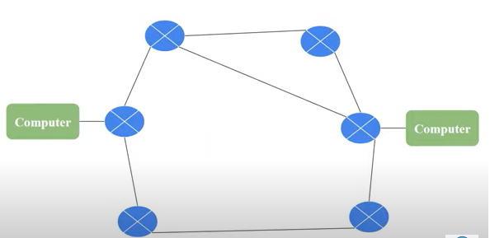
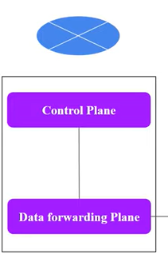

Slide 8
Introduction to SDN
The modern computer network has evolved into a complex beast that is challenging to manage and that struggles to scale to the requirements of some of today’s environments.
SDN represents a new approach that attempts to address these weaknesses of the current paradigm.
SDN is a fundamentally novel way to program the switches utilized in modern data networks.
SDN’s move to a highly scalable and centralized network control architecture is better suited to the extremely large networks prevalent in today’s mega scale data centers.
SDN is designed from the outset to perform fine-grained traffic-forwarding decisions.
Interest in SDN goes far beyond the research and engineering communities intrigued by this new Internet switching technology.
https://www.youtube.com/watch?v=quuat3SHEMY&t=604s
https://www.youtube.com/watch?v=G1doyia-xgg

Slide 9
Software defined Networking(SDN)
SDN stands for Software Defined Network which is a networking architecture approach.
It enables the control and management of the network using software applications.
Through Software Defined Network (SDN) networking, behavior of the entire network and its devices are programmed in a centrally controlled manner through software applications using open APIs.

Slide 10
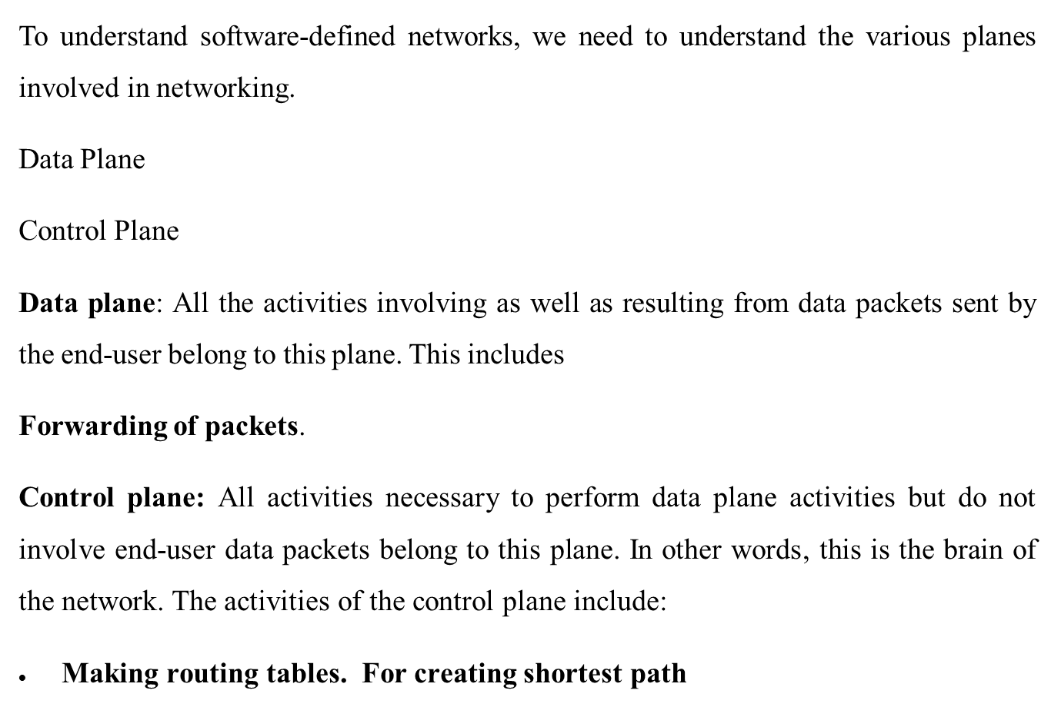

Slide 11
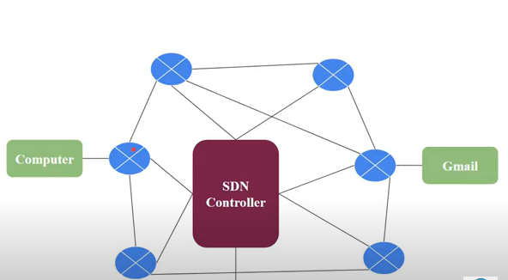

Slide 12
In traditional networks, the control and data plane are embedded together as a single unit. The control plane is responsible for maintaining the routing table of a switch which determines the best path to send the network packets and the data plane is responsible for forwarding the packets based on the instructions given by the control plane.
Whereas in SDN, the control plane and data plane are separate entities, where the control plane acts as a central controller for many data planes.

Slide 13
Why SDN?
Networking devices like Repeaters and bridges, followed by routers and switches, have been used in a plethora of environments, performing their functions of filtering and forwarding packets throughout the network toward their ultimate destinations.
Need to accelerate innovation in networking, and, in particular, the increasing demands of the modern data center.
Increase in size and complexity of many modern deployments.
Ever-increasing costs of owning and operating networking equipment.

Slide 14
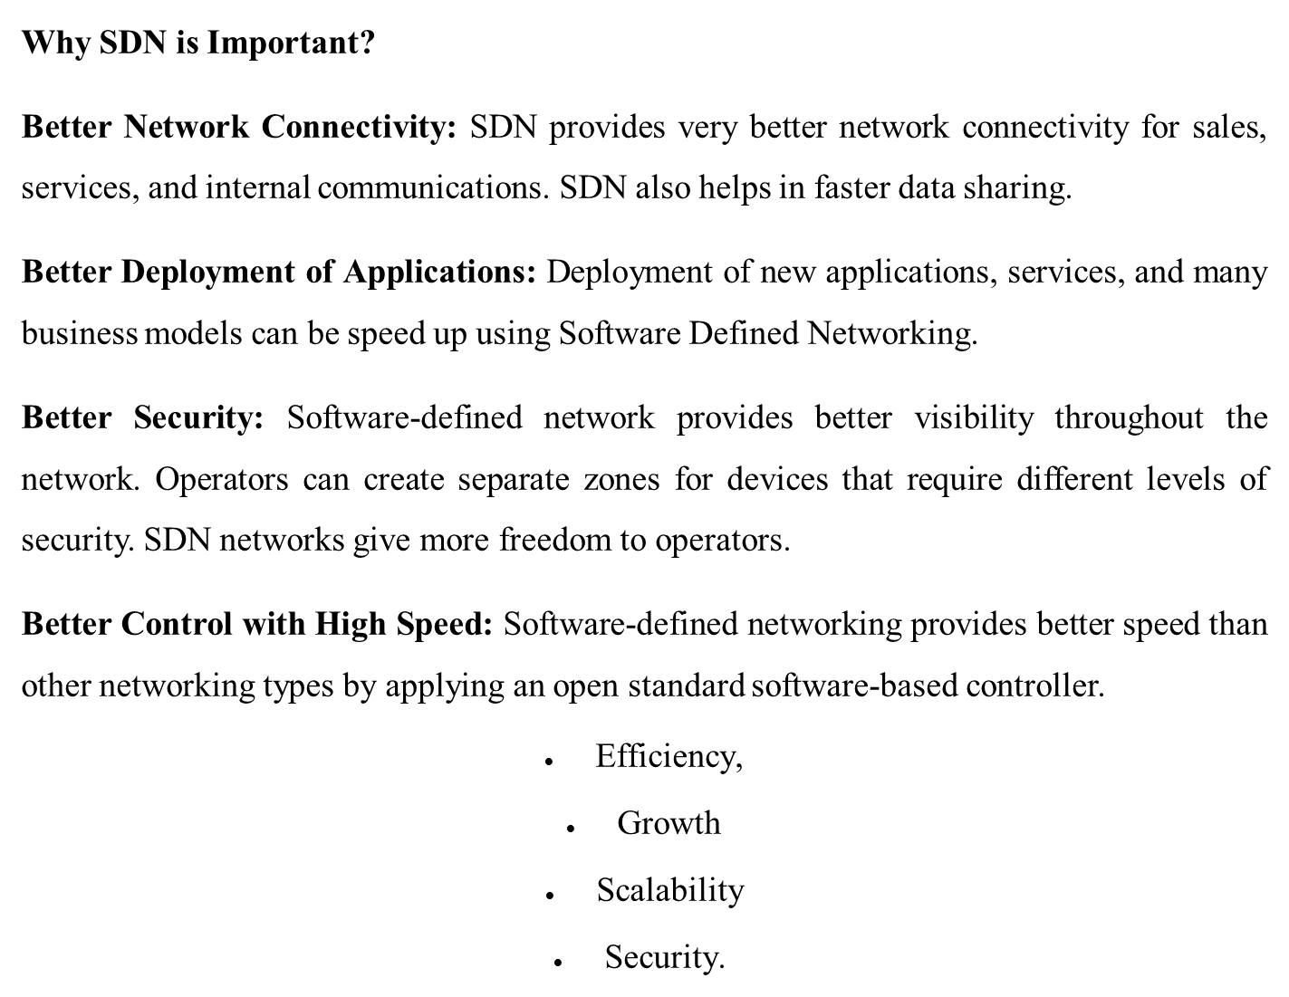

Slide 15
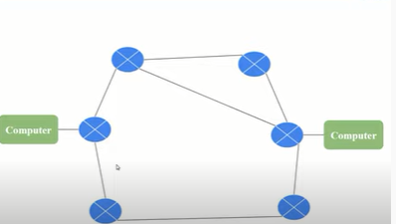
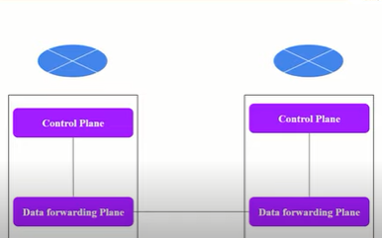
Evolution of Switches and Control Planes

Slide 16
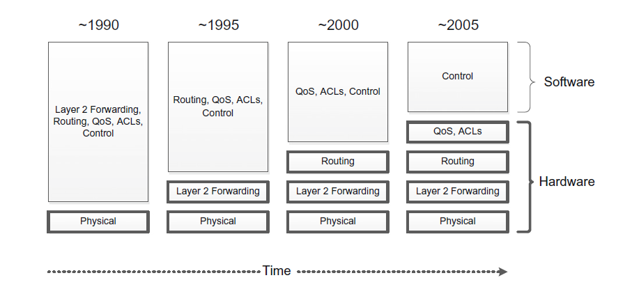
Evolution of Switches and Control Planes

Slide 17
1. Simple Forwarding and Routing Using Software
In early days of computer networking, when almost everything other than the physical layer (layer one) was implemented in software for end-user systems as well as for networking devices.
Whether the devices were bridges, switches, or routers, software was used extensively inside the devices in order to perform even the simplest of tasks, such as MAC-level forwarding decisions.

Slide 18
2. Independence and Autonomy in Early Devices
Early network device - perform in an autonomous and independent manner - because networks were generally small and fixed, with large shared domains.
A goal also was to simplify rudimentary management tasks and make the networks as plug and play as possible.
Devices relatively static configuration needs were performed manually.
Whenever coordination between devices was required, collective decisions could be made through the collaborative exchange of information between devices.

Slide 19
2. Independence and Autonomy in Early Devices
Many of the goals of this distributed model, such as simplicity, ease of use, and automatic recovery, are similar to the goals of SDN, but as the scale and complexity of networks grew, the current distributed model has become increasingly dysfunctional.
Examples of this distributed intelligence are the layer two (bridging) and layer three (routing) protocols, which involved negotiation between the devices in order to reach a consensus on the way forwarding and routing would be performed.
Spanning tree protocol
Shortest path bridging.

Slide 20
3.Software Moves into Silicon
From the figure, Forwarding and filtering decisions (process of determining which packets are allowed or denied passage through the network based on specific criteria) implemented entirely in hardware.
These decisions are driven by configured tables set by the control software above.
This movement into hardware of the lower-level decision making has yielded tremendous benefits in terms of lowering device costs and increasing performance.
Today switching devices are typically composed of hardware components such as application_x0002_specific integrated circuits (ASICs), fully programmable gate arrays (FPGAs), and Ternary content_x0002_addressable memories (TCAMs).

Slide 21
3.Software Moves into Silicon
These integrated circuits allows the forwarding decisions to be made entirely in the hardware at line rate.
This performance has become more critical as network speeds have increased from 1 Gbps to 10 Gbps to 40 Gbps and beyond.
The hardware is now capable of handling all forwarding, routing, access control list (ACL), and QoS decisions.
Higher-level control functions, responsible for network-wide collaboration with other devices, are implemented in software.
This control software runs independently in each network device.

Slide 22
4.Hardware Forwarding and Control in Software
Bridging (layer two forwarding) - handled in the hardware tables.
Routing (layer three forwarding) - To keep up with today’s high-speed links and to route packets at link speeds – implemented in hardware tables.
Advanced filtering and prioritization - ACLs, filter, forward, and prioritize packets - handled via hardware tables located in the hardware (e.g., in TCAMs) and accessed through low-level software.
Control - The control software used to make broader routing decisions and to interact with other devices in order to converge on topologies and routing paths is implemented in software that runs autonomously

Slide 23
5. The Growing Need for Simplification
One of the major drivers for SDN is simplification.
Networking devices have become increasingly complex - Placing more functionality in hardware simplifies the device but in other ways makes the device more complicated because of the difficult handshakes and tradeoffs between handling packets in hardware versus software.
Simplifying the device - Simpler, easier-to-use CPU model called reduced instruction set computing (RISC) architecture served as a reset to CPU architecture.
Simplify the management of the networks of these devices. Rather than using primitive network management tools such as SNMP and CLI, network operators would prefer to use policy-based management systems. SDN may enable such solutions .

Slide 24
6.Moving Control Off the Device
SDN is about moving the control software off the device and into a centrally located compute resource that is capable of seeing the entire network and making decisions that are optimal, given a complete understanding of the situation.
SDN segregates network activities in the following manner:
Forwarding, filtering, and prioritization - Implemented in hardware tables, remain on the device.
Control - Complicated control software is removed from the device and placed into a centralized controller, which has a complete view of the network and the ability to make optimal forwarding and routing decisions.
Application - Above the controller is where the network applications run, implementing higher-level functions and, additionally, participating in decisions about how best to manage and control packet forwarding and distribution within the network.

Slide 25
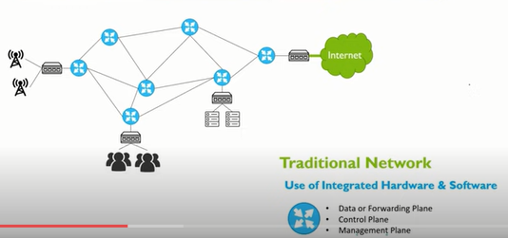
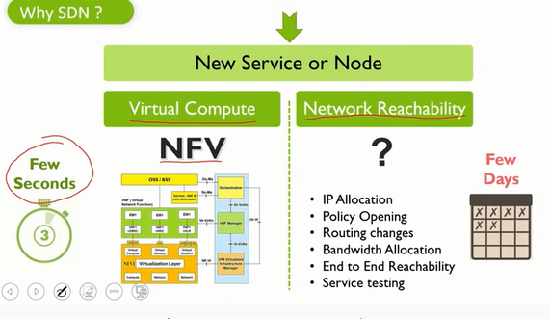
Why SDN

Slide 26
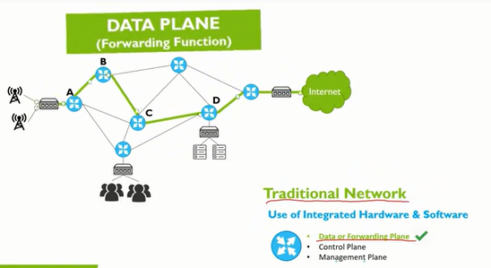
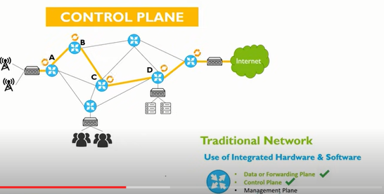

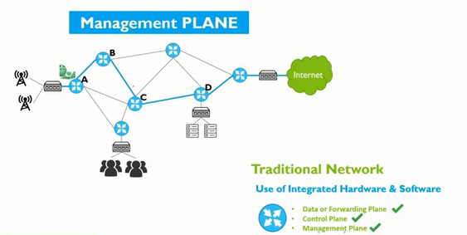

Slide 27
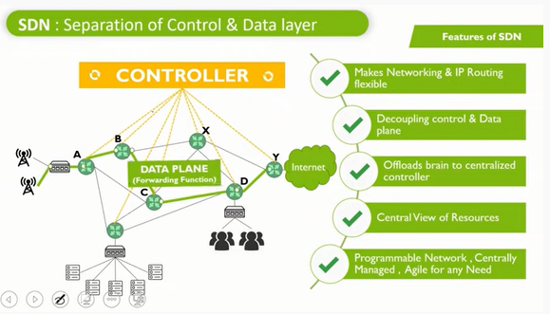
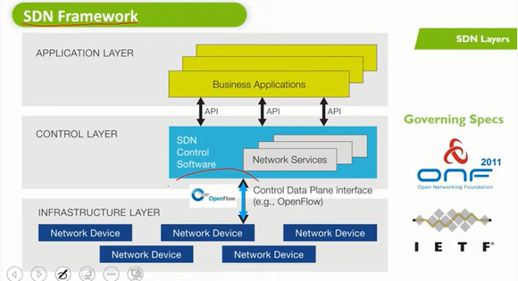

Slide 28
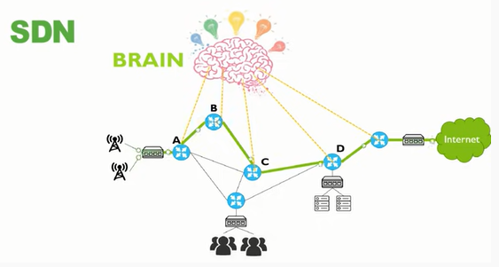
Cost
Need for SDNs often include cost as a driving factor

Slide 29
1. Increased Cost of Development
Today’s autonomous networking devices must store, manage, and run the complicated control plane software - manifested in increased cost per device due to the processing power required to run that advanced software as well as the storage capacity to hold it.
Software developers reuse code provided by common frameworks and concentrate on solving domain-specific problems.
Each vendor would have to develop, test, and maintain large amounts of redundant code, which is not the case in an open software environment. With the closed networking environment, each vendor must implement all of the common functionality required by their devices. This clearly increases the costs attributable to software development.

Slide 30
1. Increased Cost of Development
In recent years, silicon vendors have been producing common off-the-shelf (COTS) ASICs that are capable of speeds and functionalities that rival or surpass the proprietary versions developed by networking hardware vendors.
Vendors are not able to efficiently make use of their merchant silicon chips, since software must be reengineered for each product line.
The fact that such a large body of software must run on each and every network device serves to further increase this cost.

Slide 31
2. Closed Environments Encourage Vendor Lock-in
Vendors do their best to implement these standards in a manner that allows heterogeneous networks of devices from multiple vendors to coexist with one another.
Each vendor product will have difficulty interoperating smoothly with products from another vendor.
Adherence to standards helps alleviate the issues associated with attempting to support multiple vendor types in a network, but problems with interoperability and management often far outweigh the advantages that might be gained by choosing another vendor.
As a result, customers frequently become effectively married to a vendor they chose years or even decades before.
This sort of vendor lock-in alleviates downward pressure on cost because the vendor is largely safe from competition and can thus preserve high profit margins

Slide 32
3. Complexity and Resistance to Change
Quite often in networking we arrive at a point of having made the network operational, and the normal impulse from that point on is to just leave things as they are, to not disturb things lest the system break and require us to start all over again.
Others may have been burned by believing the latest vendor that proposed a new solution and, when the dust settled, their closed, proprietary, vendor-specific solution was just as complex as that of the previous vendor.
Unfortunately, in spite of efforts at standardization, there is still a strong argument to stay with that single-vendor solution.
That resistance to change results in long-term technological stagnation and sluggishness.
The ideal would be a simpler, more progressive world of networking, with open, efficient, and less expensive networking devices. This is a goal of SDN

Slide 33
4. Increased Cost of Operating the Network
As networks become ever larger and more complex, the operational expense (OPEX) of the network grows.
This component of the overall costs is increasingly seen to be more significant than the corresponding capital expense (CAPEX) component.
SDN has the capacity to accelerate the automation of network management tasks in a multivendor environment.
This, combined with the fact that SDN will permit faster provisioning of new services and provides the agility to switch equipment between different services, should lead to lower OPEX with SDN.
SDN may be used in the future to reduce the power consumption of the networking equipment in a data center, which is another major contributor to network OPEX

Slide 34
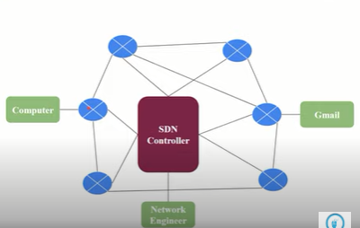
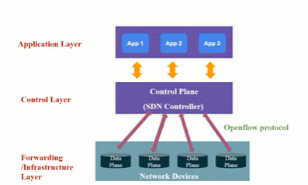
SDN Implications for Research and Innovation

Slide 35
SDN Implications for Research and Innovation
Networking vendors control networking devices from the bottom up: the hardware, the low-level firmware, and the software required to produce an intelligent networking device.
This platform on which the software runs is closed, and consequently only the networking vendors themselves can write the software for their own networking devices.
The Java Virtual Machine and the Netbeans Integrated Development Environment provide a good example of cross-platform development methods. Using such tools, we can develop software that may be ported between Windows PC, Linux, or Apple Mac environments.

Slide 36
1. Status Quo Benefits Incumbent Vendors
The collective monopolies extant in the networking world today are advantageous to networking vendors.
Although periodically new networking companies emerge to challenge the status quo, that is the exception rather than the rule.
The result is that the competitive landscape evolves at a much slower pace because when the current status quo is generating reasonable profits due primarily to the lack of real competition and the resulting high margins they are able to charge for their products.
Without a more competitive environment, the market will naturally stagnate to some degree. The small players will struggle to survive, attempting to chip away at the industry giants but with limited success, especially since the profit margins of those giants are so large.
This competition-poor environment is unhealthy for the market and for the consumers of products and services.

Slide 37
2. SDN Promotes Research and Innovation
Universities and research labs are focal points of innovation. In technology, innovations by academia and other research organizations have accelerated the rate of change in numerous industries.
If researchers are working in the area of operating systems - Open software environments such as Linux can be modified.
If they are working in the area of server virtualization or databases - KVM or Xen and MySQL or Postgres.
All of these open source packages are used in large-scale commercial deployments.
Unfortunately, the current closed nature of networking software, network protocols, network security, and network virtualization is such that it has been challenging to experiment, test, research, and innovate in these areas.

Slide 38
2. SDN Promotes Research and Innovation
This fact is one of the primary drivers of SDN.
A number of universities collaborated to propose a new standard for networking called OpenFlow, which would allow for this free and open research to take place.
This makes one wonder if SDN will ultimately be to the world of networking what Linux has become to the world of computing.
General innovation, whether from academia or by entrepreneurs, is stifled by the closed nature of networking devices today.
The more that the software and hardware components of networking are commoditized, the lower their cost to customers.
SDN promises both the hardware commoditization as well as openness, and both of these factors contribute to innovation.
Innovation is also driven by the prospect of generating wealth.

Slide 39
REVIEW QUESTIONS
In early days of computer networking, when almost everything other than the ______________was implemented in software for end-user systems as well as for networking devices.
Early network device perform in __________and ____________ manner because networks were generally small and fixed, with large shared domains.
Simplifying both the _______and _____________ is one of the major drive for SDN.
___________ encourage vendor lock-in.
A number of universities collaborated to propose a new standard for networking called __________, which would allow for the free and open research to take place.

Slide 40
ANSWERS
Physical Layer
Autonomous and Independent
Network Devices and the management of the network
Closed Environments
OpenFlow

